Slide 1
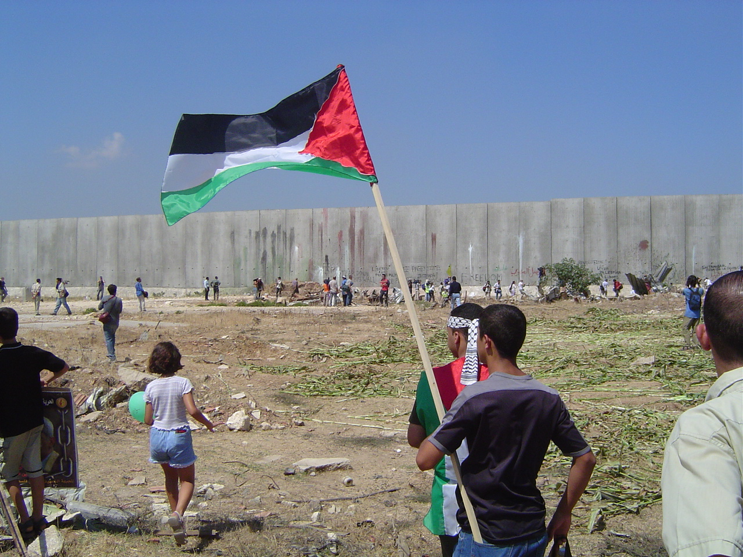
Palestinian Grassroots
Anti-Apartheid Wall Campaign
www.StoptheWall.org
2002 - 2010

Slide 2
For Sustainable Ghettoes:
Donor Money & the Israeli Economic Vision for the WB & Gaza

Slide 3
Israel Master Plan “Israel 2020”
In Israel, trends is further augmented by a general political consensus, bridging all political parties, that the Israeli-Palestinian conflict will not be resolved within the next few decades - hence Israel should see itself as a "marathon runner" and build a strategy for long term resilience.
The Master Plan first faze was launched in 1992 involved 250 Israeli professionals from the Academia, Ministries, Private sector, Unions, Military & Some Israeli NGOs and international Jewish agencies.
In 1997, or after 6 years, They came out with 18 report to the general public.
These reports provided a pioneering example for comprehensive long range Israeli national planning in major two atmospheres: The WAR atmosphere and the PEACE atmosphere.

Slide 4
Who were within the “professionals”?
Professors from Dublin & Walberg universities in Denmark, Hawaii Cambridge university, The Royal Technical Institute in Sweden, Toskopeh university in Japan, Nimikhin in Netherlands, Leil in France, Harvard in the USA & The Technical University in Berlin.
Why there were needed?
To understand and measure the new and expected International trends in Politics, Aid, Economic, Religious, Tourism, Hi-Tech, Military, National Security,,, etc.
New International trends Such as:
Qualified Industrial zones, Border industrial zones,,, etc
Green Energy, Green housing, Environment,,, etc
Aid theories & Foreign relations theories
Theories related Private sectors roll in peace building
Trade trends within Bilateral agreements, Multilateral agreements, WTO,,, etc
Economical Coalitions: EU, OECD, Mercusure,,, etc
Developed countries, developing countries and the rest of the world.

Slide 5
Herzliya Conference
started in 2000 until today on yearly bases
1- Galilee Development (Judaisation) plan
2- Negev Development (Judaisation) Plan
3- Greater Jewish Jerusalem
4- Disengagement Plan from WB & Gaza
www.herzliyaconference.org/Eng/

Slide 6
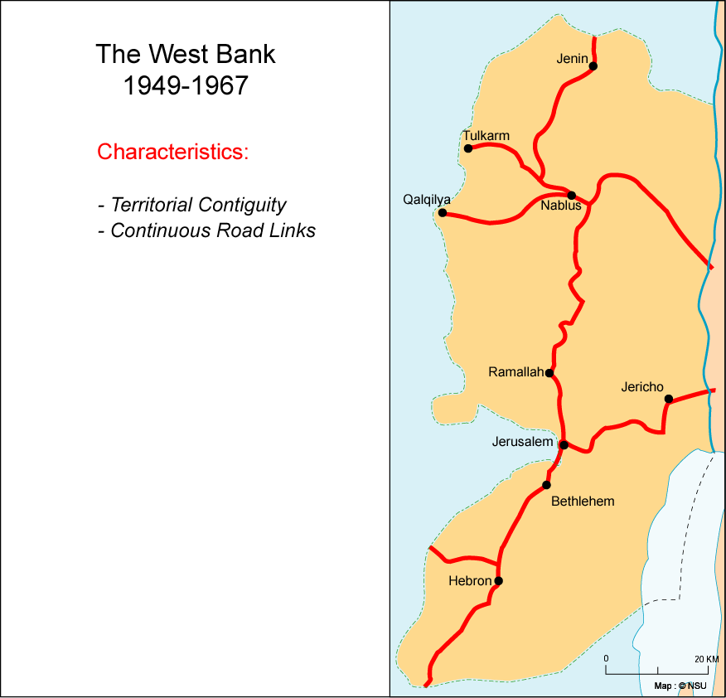
“The need for a viable Palestinian state with contiguity on the West Bank”
George Bush, 2003
Notes:
In maps we shows all the paln

Slide 7
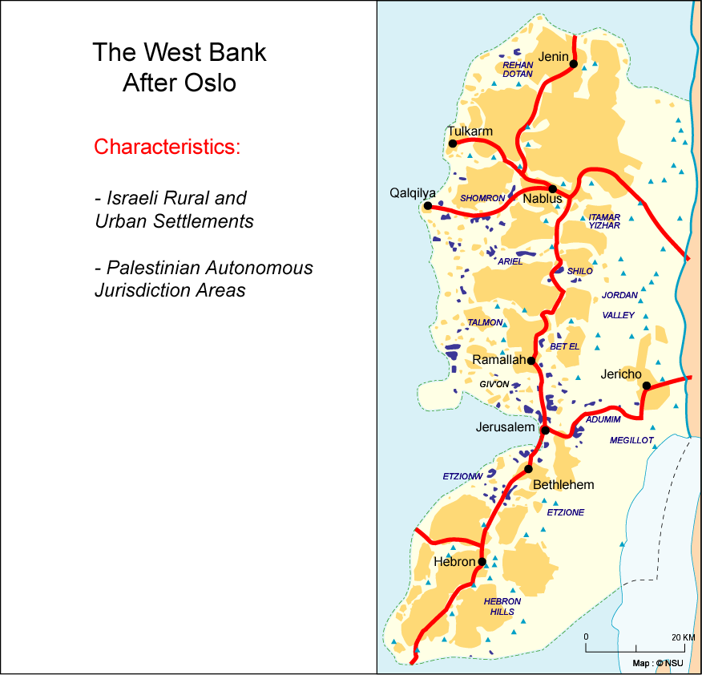
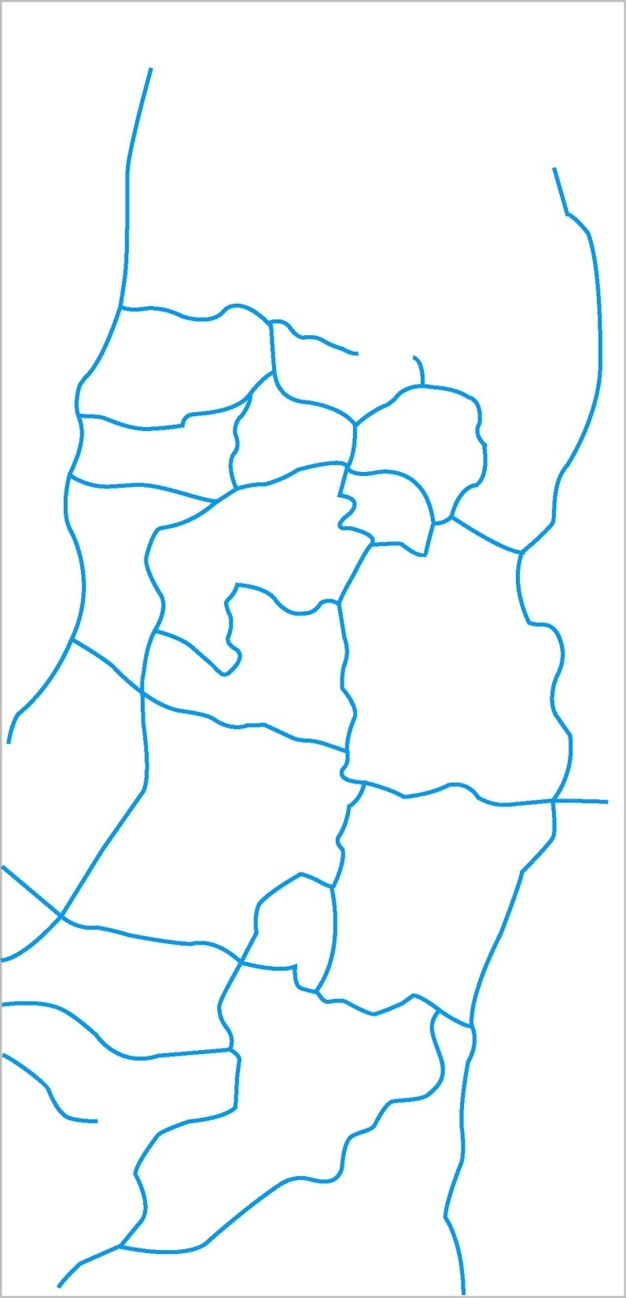
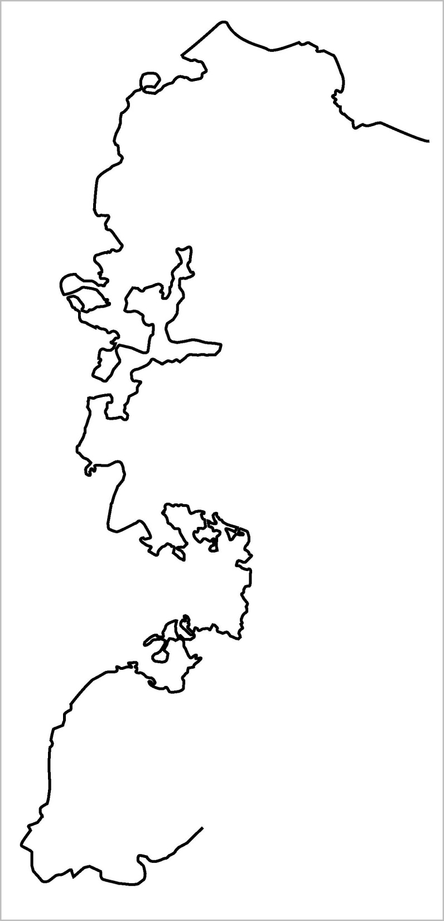
West Bank Post- 1967
Israeli governments established settlements in WB & Gaza:
Labor Governments (2): Established 62 Settlement in WB and encouraged 183,000 settler to move to WB.
Likud Governments (4): Established 186 Settlement in WB and encouraged 228,000 settler to move to WB.
One unity government: Encouraged 78,000 settler to move to WB.
The 810 KM of the Apartheid Wall is the single largest infrastructure project in Israel. The total cost of the project has been estimated at approximately NIS 13 billion (US$ 3.3 billion).
The Wall construction involved (as of January 2007) 700 different subcontractors: around 60 planning offices, 53 major construction firms, 5 wire-fence firms, 11 civilian security firms and about 34 producers of surveillance and communications.
In 2005, the Israeli Army announced that they needed to install USD 400 million worth of hi-tech to secure the Apartheid Wall & checkpoints.
The Apartheid Wall confiscates 12% of total WB land, including Jerusalem. Military zones continue to control 30% of the WB.
82% of the water resources will remain under Israeli control, forcing Palestinians to re-buy their own confiscated water.
There are 1,400 kilometers (875 miles) of paved roads in the West Bank alone. Israel control 1200 Km of them until today.
In August of 2008 there were 794 kilometers of by-pass roads in the West Bank and unclear number of planned kilometers of road Israel is still planning to build.
All bypass roads have a 50–75m buffer zone on each side, where no construction is allowed.
The cost of paving a kilometer of road is NIS 15-25 million, so it is possible to estimate the Israeli investment in West Bank bypass roads over the years, including their maintenance by NIS 10 billion (2 billion USD).
These roads confiscated around 1.54% of total West Bank lands.
55% of a total of 489,000 settler moved to WB after 1992, while
Settlements expansion was:
Between 1991-1992: 9.1%
Between 1993-1995: 3%
Between 1996-1999: 9.9%
Between 2000-2006: estimated 5%
In 2008, constructions in settlements was 28% increased over the same period in 2007.
Settlement Built-up areas colonized 3.3% of WB & Settlers population is considered 12% only from the total population of West Bank BUT they dominate more than 40 percent of the West Bank.
Notes:
Then in 1983 they started the jewish only by-pass roads. 500km of roads networks totally cut the westbank into slides and provided settlements with contiguity. Then the zionist project was developed in 2000 by the wall insuring sustainability of occupations and settlements. In 2003 bush, israel, UN and the world started talking about a “viable” Palestinian state with “contiguity”. WHY?

Slide 8
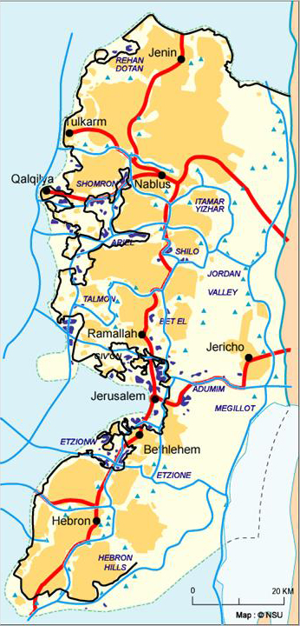
The de-development plan in the WB
The Apartheid Wall, settlements, military zones and bypass roads confiscate around 46% of the West Bank total land.
They will confiscate the water resources, destroy the agricultural industry, cut the WB from the rest of the world, forbid Palestinians from investing in the Dead Sea and devastate the touristic industry.
They will cut the West Bank into around 22 isolated ghettos. This is in addition to Gaza, which is already cut off and isolated from the West Bank.
Isolating the Palestinian political capital, Jerusalem.
810 Km of walls, 531 obstacles (road blocks, flying checkpoints, etc.) will allow only a restricted continuity through 44 tunnels and 34 checkpoints.

Slide 9
The apartheid roads network carves across the West Bank
Projected scope of Israeli disengagement
Tunnels / alternative Palestinian thoroughfares

Slide 10
The Apartheid road network around Nablus
Notes:
This is the tunnels plan around Arial settlement or finger.

Slide 11
Types of industrial zones:
1.Settlement Industrial zones – of the largest 12 settlements, many announced projects to expand industrial zones in 2006-2007
2.“Joint industrial zones” – Jenin, Hebron, Jericho and Gaza
3.“Border Industrial zones”
4.Agro-Industrial zone – located in the Jordan Valley
5- Tourist industry
6- Other industries – Electricity, Water, Services, Banking ...etc

Slide 12
Palestinian Labour
cheap, mobile labour force, with no social rights
Palestinian industry to provide low-paid labour
Israeli industry to provide high-margin technological and logistic expertise
Salaries forced by Israeli Companies (AV. Of $300/month)
Industrial zones & Checkpoints built on a Palestinian confiscated lands to operate as: “Joint peace building industrial zones with international crossing points for foreign trade”
Prevention of the development of Palestinian industry.
Weakening of trade unions
Becoming the main labour pool for the growing number of Israeli ‘small economy’ sectors, such as agriculture, construction, services, textile, IT, and low-technology civilian manufacturing
US, EU and Gulf Markets using FTA, bi-literal & WTO laws & agreements

Slide 13
Japanese / Quartet agro-industry development proposals

Slide 14
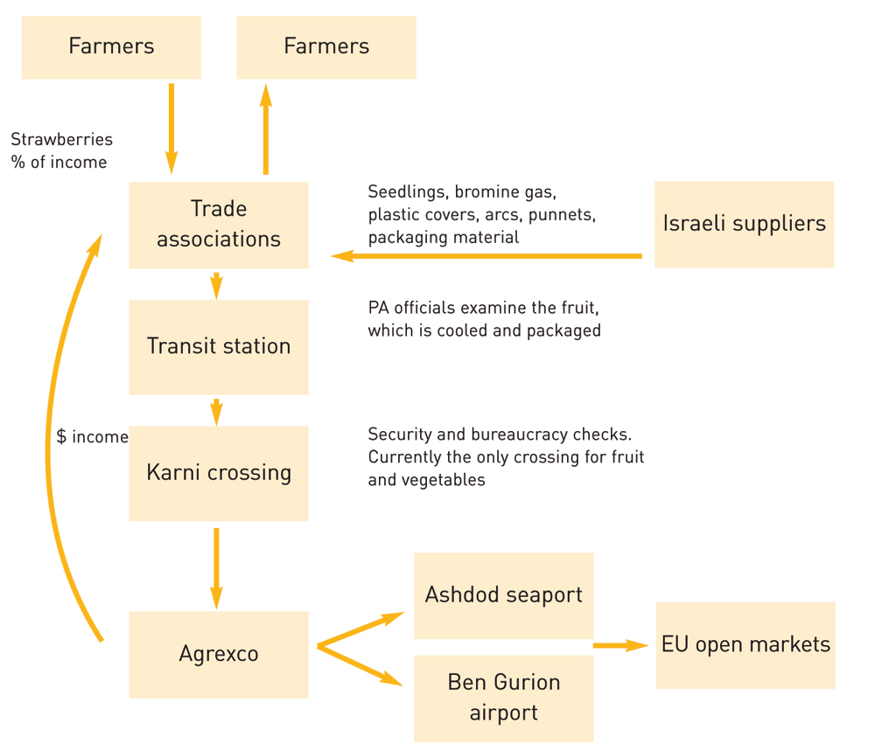
Palestinian Farmers
Palestinians to abandon their own farms
& to work as low-paid, low-skilled labourers
Palestinian industry to provide low-paid labour
Israeli industry to provide high-margin technological and logistic expertise
Checkpoints built on a Palestinian confiscated lands to operate as: “legal international crossing points”
Price & income is forced by Israeli Compani-es
Prevention of development a Palestinian export industry. All Exportation is through Israeli Companies only.
US, EU and Gulf Markets using FTA, bi-literal & WTO laws & agreements
Agrexco & other Israeli companies

Slide 15
Export oriented Agro-industry
Benefits to the Israeli Economy
According to Israeli agricultural experts, current Israeli agricultural infrastructure and markets can enable an increase of agricultural exports by as much as 30% (equivalent to some US$300 million) IF an adequate and stable supply of Palestinian workers is assured.
It is clear that Israeli-Palestinian cooperation in the field of agriculture is beneficial for the Palestinian economy. It is important to note, however, that such cooperation is extremely beneficial for the Israeli economy as well, through: (1) the direct Israeli involvement in Palestinian agro-businesses (via partnerships, joint-ventures etc.); and (2) the sale of Israeli inputs and services to Palestinian agro-businesses.
“The Untapped Potential – Palestinian-Israeli Economic Relations: Policy Options and Recommendations”, by Paltrade and Peres Center for Peace, 2006;
Furthermore, The Palestinian economy recovers, most of Palestinian industrial and agricultural income will be in the form of
Value Added Income Only

Slide 16
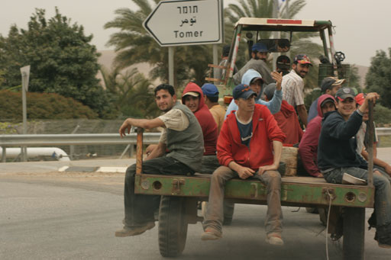
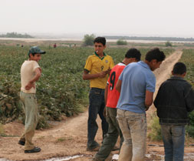
Family-Based Business
Father,
Mother
… and children

Slide 17
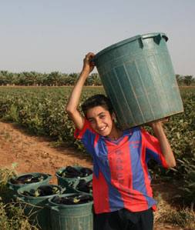
The Jordan Valley has the highest percentage of child labour in the West Bank & Gaza
Recorded levels of child labor increased from 3.1% in 2004 to 4.2% in 2006, with the highest increase recorded among girls (from 0.7% to 3.1%).
CHILD RIGHTS FACT SHEET, Save The Children - UK, 2007
Most of the children (74% children) are employed in
as non-paid family employees. And 20.9% as paid employees
41.8% work in agriculture sector
Palestinian children – statistics and figures- PCBS 2007
70% are women child labor

Slide 19
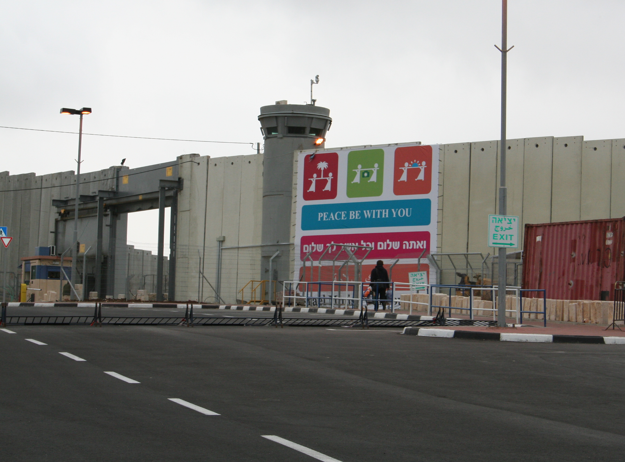
The road to Bethlehem is sealed by a checkpoint. Travel is impossible for Palestinians without a Jerusalem ID card. Tourists will have a “special area” in the checkpoint.

Slide 20
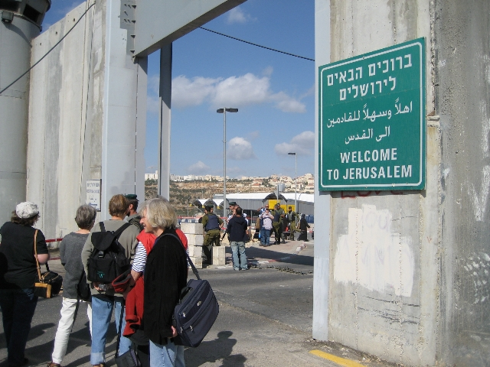
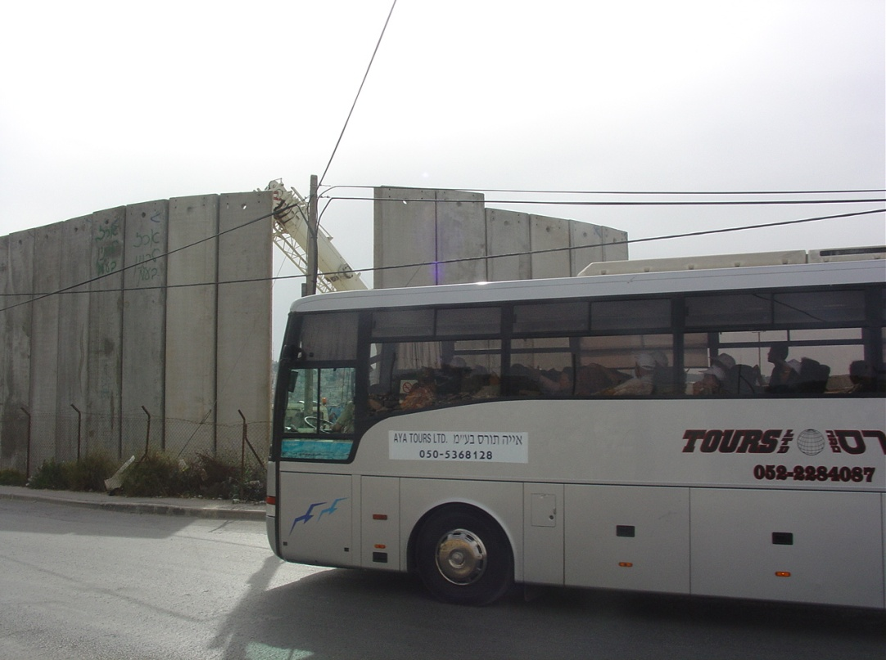
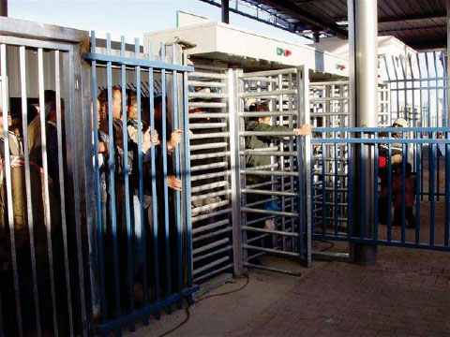
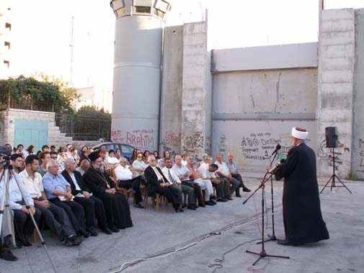

Slide 21
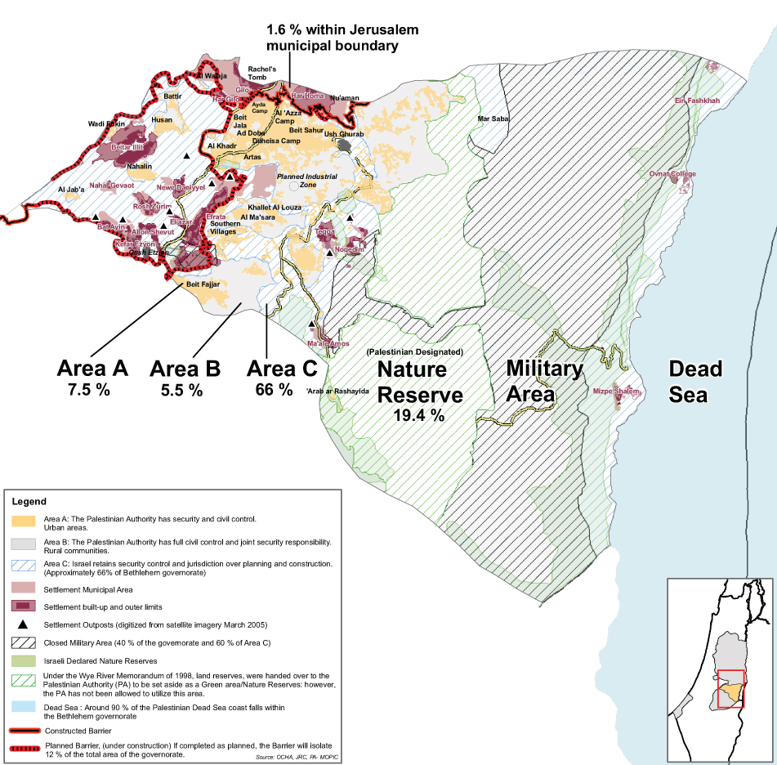

Slide 22
Total number of tourists to Bethlehem in 2007: 509,980 tourists
Palestinian Ministry of Tourism
Total guest nights spent in Bethlehem hotels in 2007: 201,041 nights
Palestinian Ministry of Tourism
The average length of stay in the Palestinian hotels was 2.5 nights per guest during the year 2006.
Population, Housing and Establishment Census – 2007, PCBS
That means around only 80,416 slept in Bethlehem leaving
429,563 sleeping in Israeli hotels.
Most of the East Jerusalem settlements’ expansion projects
include touristic sites and hotels

Slide 23
The Palestinian average income per tourist was around US$200, only 15% of the Israeli income per tourist (PCBS and the Palestinian Ministry of Tourism, cited in International Alert report “Local Business Local Peace” 2006, p. 383)… Christian tourists in Israel can generate an average direct income per tourist that is similar to the current Israeli average of US$1,300 with an additional US$300-500 per tourist that will be spent in the PA.
“The Untapped Potential – Palestinian-Israeli Economic Relations: Policy Options and Recommendations”, by Paltrade and Peres Center for Peace, 2006;
The combined number of water springs isolated by the western Isolated areas by the Apartheid Wall is 62 with a combined average annual discharge of approximately 31 MCM. Up to 221 dunums (0.221 Km2) of inland water are isolated in the Western Isolated areas by the Apartheid Wall and 685 dunums (0.685 Km2) in the Eastern “Military zone” (Jordan Valley) , both of which constitute 99% of the total inland-water area in the West Bank.
Geopolitical Status of Bethlehem Governorate, ARIJ, 2007

Slide 24
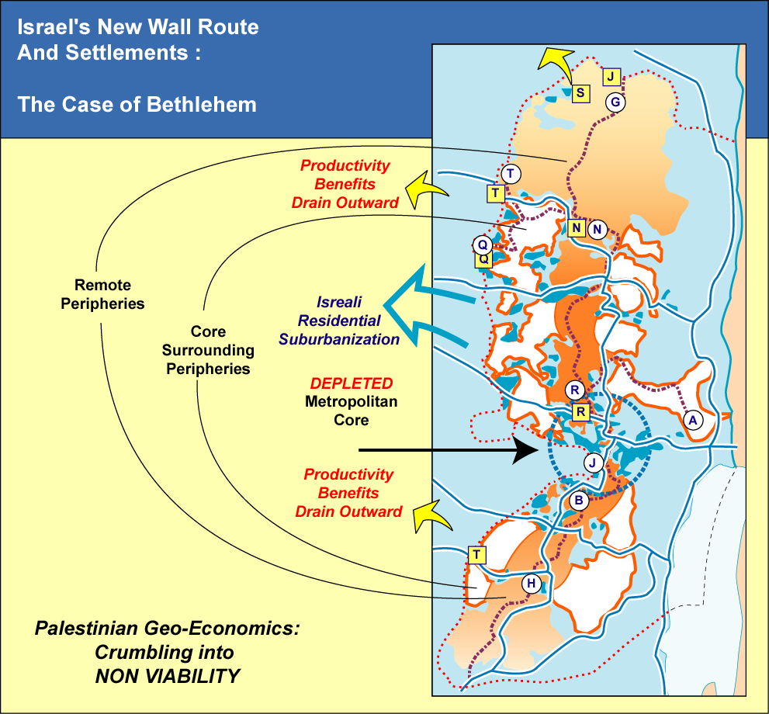
Notes:
Viability will mean 9 to 12 industrial zones all along the west bank. Because of the wall and the roads palestine will lose most of it’s agricultural lands and water. That will lead to a total economic destruction and food insecure. The world bank respond was to build these jewish zones and provide it with a cheap slavery palestinian workers instead of ending occupation. The palestinian community will be totally changed from an independent farming community to a slavery workers community depending totally on occupation. 3 industrial zones are under construction. One in Jalama (J) funded by the German government, Tulkarem (T) funded by the USAID and Tarqomiya (T south) funded by the world bank.

Slide 25
12%
13%
of Palestine
of South Africa
Notes:
Most of the “ideas” was imported from the apartheid regime of south Africa. The ghettos, the industrial zone and even an idea of “pre-paid system” for water and electricity was taken from there. What will be left from palestine is 12.5% and it is almost what was given to the Africans in south africa.

Slide 26
South Africa
Palestine
Notes:
also., the ID system and car plates was taken from south africa

Slide 27
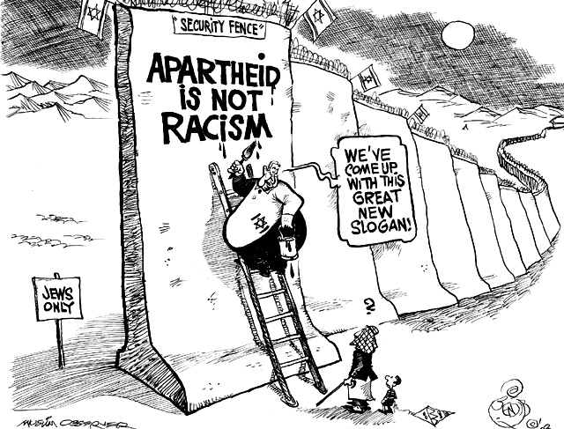

Slide 28
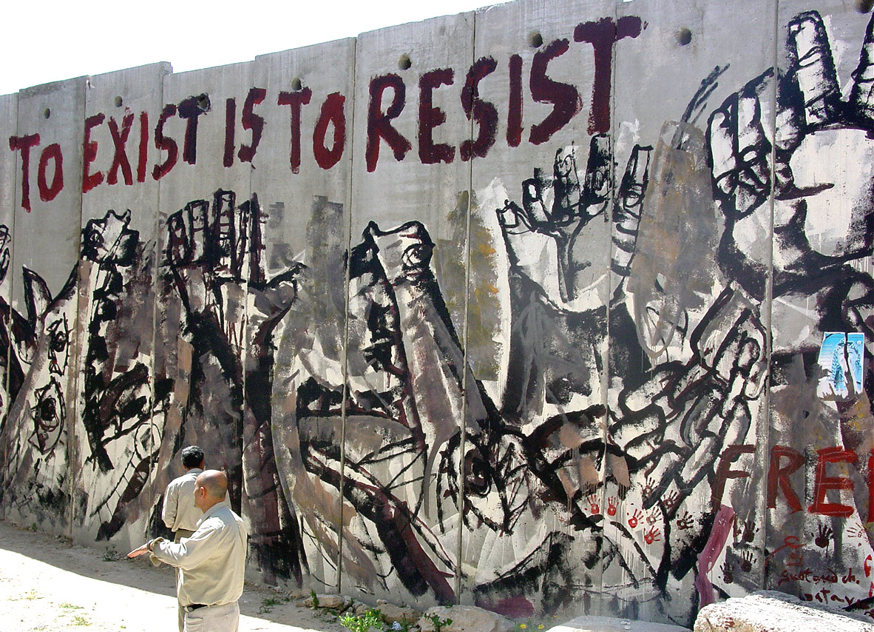
But the resistance will Continue …

Slide 29
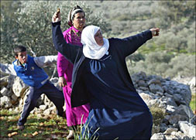
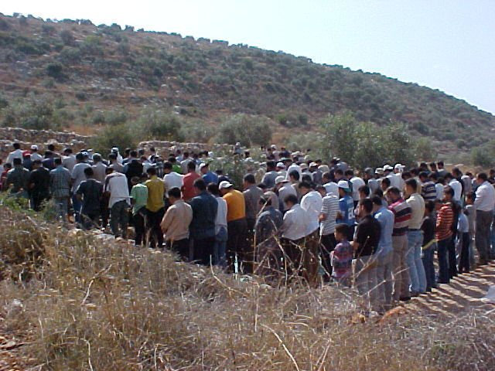
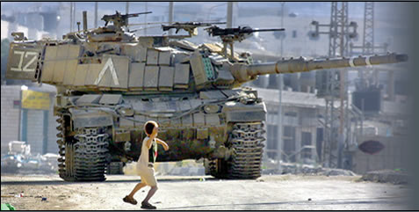
We are part of this land, its air, its history. And we will be its future.
We have no other choice but RESISTANCE

Slide 33
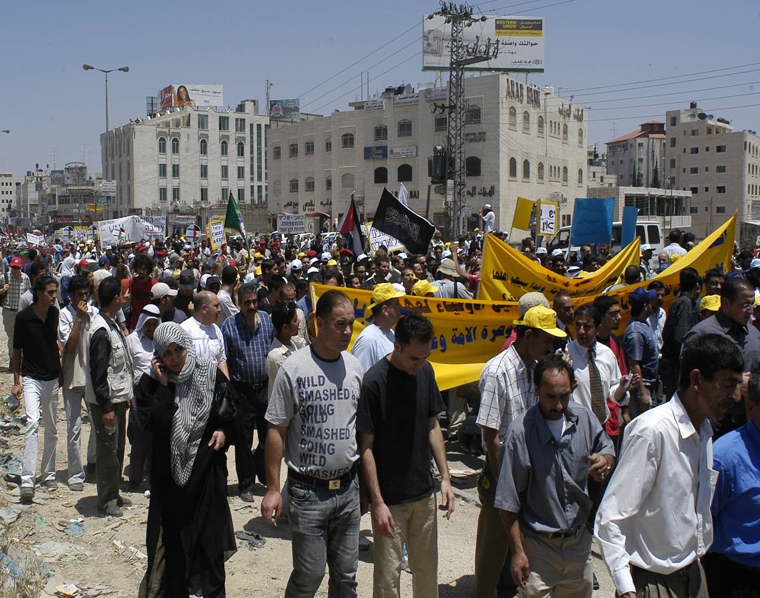
Demonstrations:
Ar-Ram has been cut in two by the Apartheid Wall

Slide 34
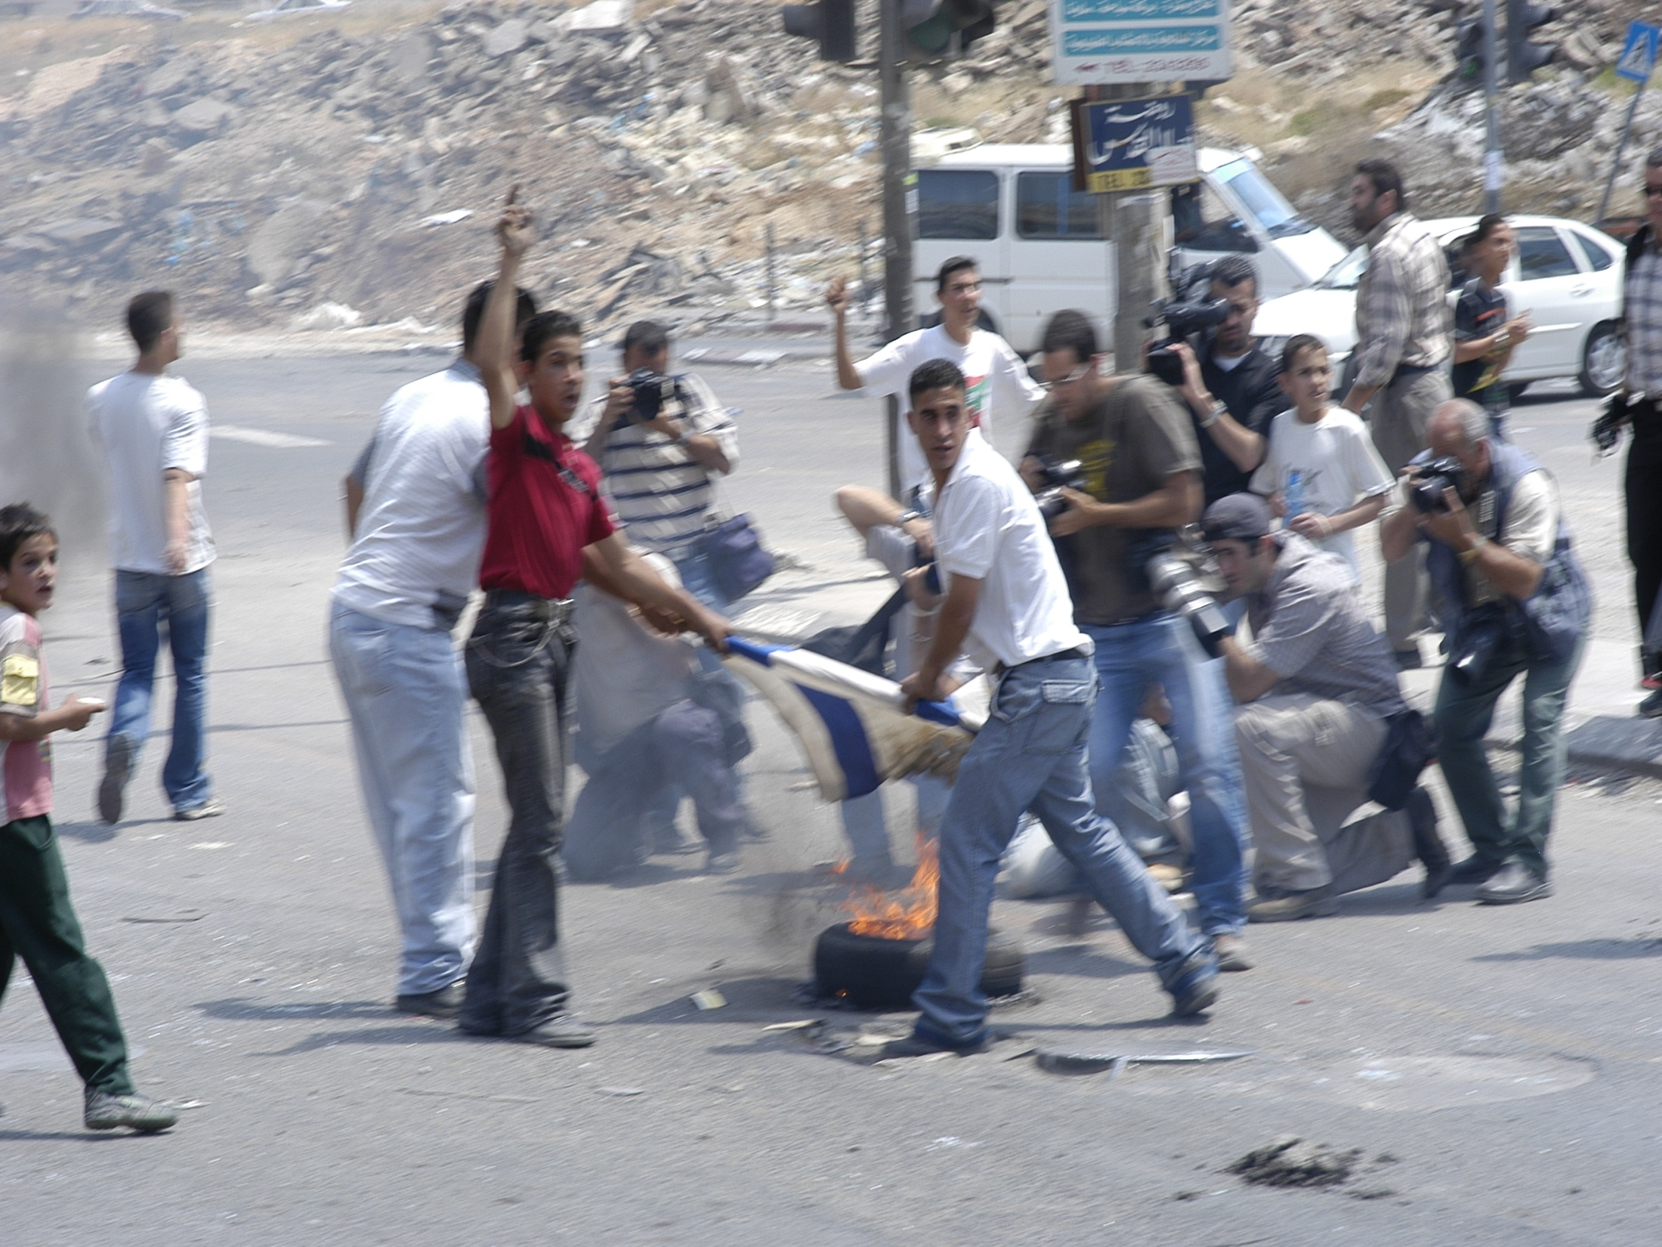
Public protest

Slide 35
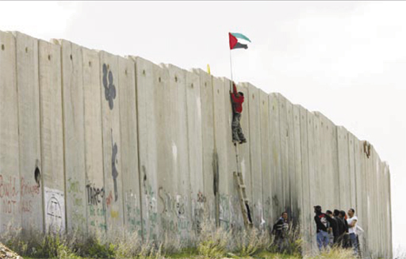
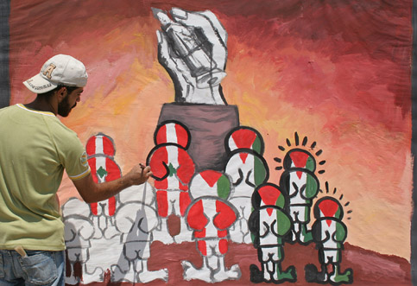

Slide 36
www.stopthewall.org
Dawood Hammoudeh
mobilize@stopthewall.org
Tel: +972-2-2972505
Fax: +972-2-2975123
Let us Work Together to Stop the Occupation and Apartheid !
Free Palestine!
Notes:
For any updates for the presentation, please contact PENGON or visit our website.

Slide 37
www.stopthewall.org
Dawood Hammoudeh
mobilize@stopthewall.org
Tel: +972-2-2972505
Fax: +972-2-2975123
Let us Work Together to Stop the Occupation and Apartheid !
Free Palestine!
Notes:
For any updates for the presentation, please contact PENGON or visit our website.

